Slide 1
The basics
Python: Next steps
3rd Edition

Slide 2
Objectives
Read and understand an existing Python program
Recall different data types
Use the int(), float() and str() functions to convert data types
Write an if-else statement

Slide 3
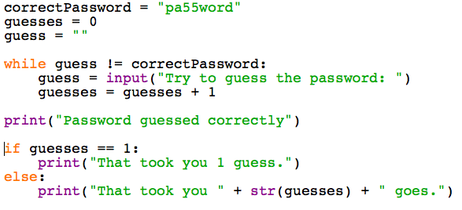
Starter
Reading Code: What does this program do?

Slide 4
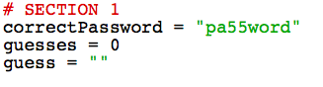
Section 1
Sets the values of three variables
correctPassword
guesses
guess

Slide 5
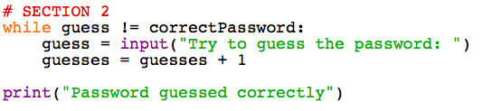
Section 2
Keeps running while the guess is different from the correct password
Asks the user to have a guess
Counts the number of guesses

Slide 6
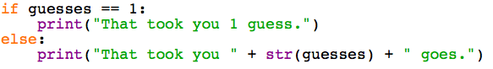
Section 3
Works out how many guesses it took and prints out the result
What would happen if you just had the last line and made 1 guess?

Slide 7
Data types
Variables have to be a certain type
A + B = AB
Does 3 + 7 = 10? or 37?
“A” is a string (or text)
3 is an integer (or whole number)
1.618 is a float (or decimal fraction)

Slide 8
Data types
In IDLE’s Interactive Mode type these lines and compare the results:
value = "3"
print (value + value)
value = 3
print (value + value)

Slide 9
Casting
Casting is the technical name for converting a variable from one data type to another
In IDLE type the following lines:
value = "3"
print (value + value)
value = int(value)
print (value + value)

Slide 10
int() and float()
If you need a whole number, use int
If the number has a decimal place, use float
In IDLE type the following lines:
value = 1.618
print (value)
value = int(value)
print (value)

Slide 11
Using str() to print
It can be tricky to print a number, so use str() to turn it into a string
In IDLE try the following lines:
money = 15
print("You have £" + money)
You will get an error. Try this:
print("You have £" + str(money))

Slide 12
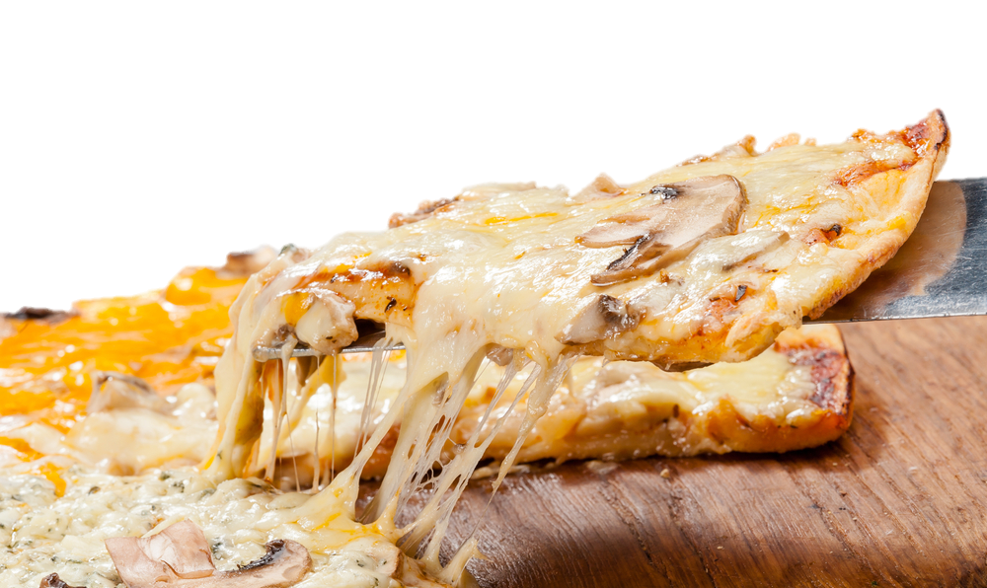
Worksheet 1a
Complete the three tasks

Slide 13

If statements
If you have a brother or sister then hold your left hand in the air
Now put your hands down

Slide 14

If – Else statements
If you have a brother or sister then
hold your left hand in the air
Else (if you don’t) then
hold your right hand in the air
Now put your hands down

Slide 15
If – Elif - Else statements
If you have only a brother then
hold your left hand in the air
Else if you have only a sister then
hold your right hand in the air
Else (everyone else) then
hold both arms out like zombies

Slide 16
Python syntax
if hasASister == True:
leftArm = "up"
elif hasABrother == True:
rightArm = "up"
else:
leftArm = "zombie" rightArm = "zombie"

Slide 17
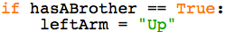
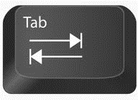
Common mistakes
Each if, elif or else needs a : at the end of that line (think “then”)
Always use a double equals (==) for a test
The instructions for what to do need to be indented (use the Tab key)

Slide 18
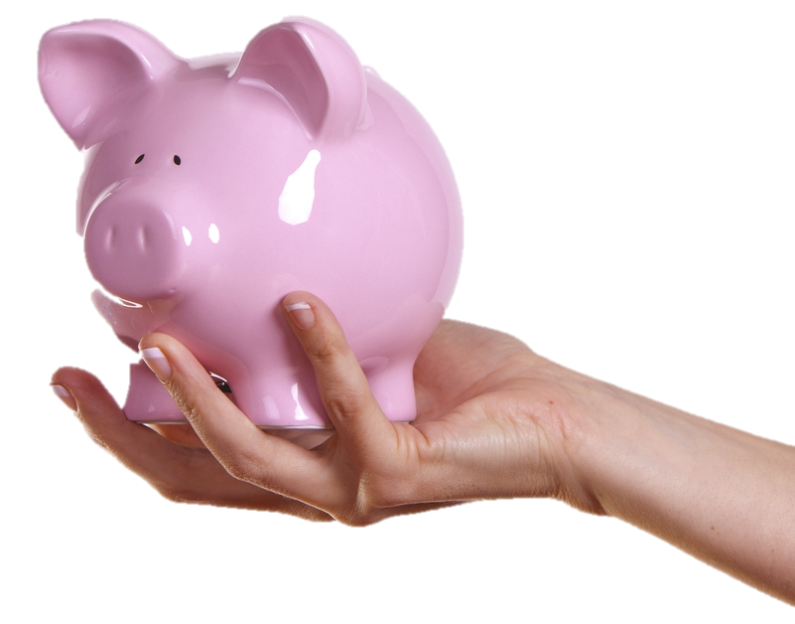
Worksheet 1b
Complete the three tasks

